Slide 1

Project No. 15006313
Unity Seminar
Project Member: Melanie Sverdlov
Seminar Advisor: Moshe Sulamy

Slide 2
Card Game Simulator is a video game that aims to simulate various card games in a tabletop way

Slide 3
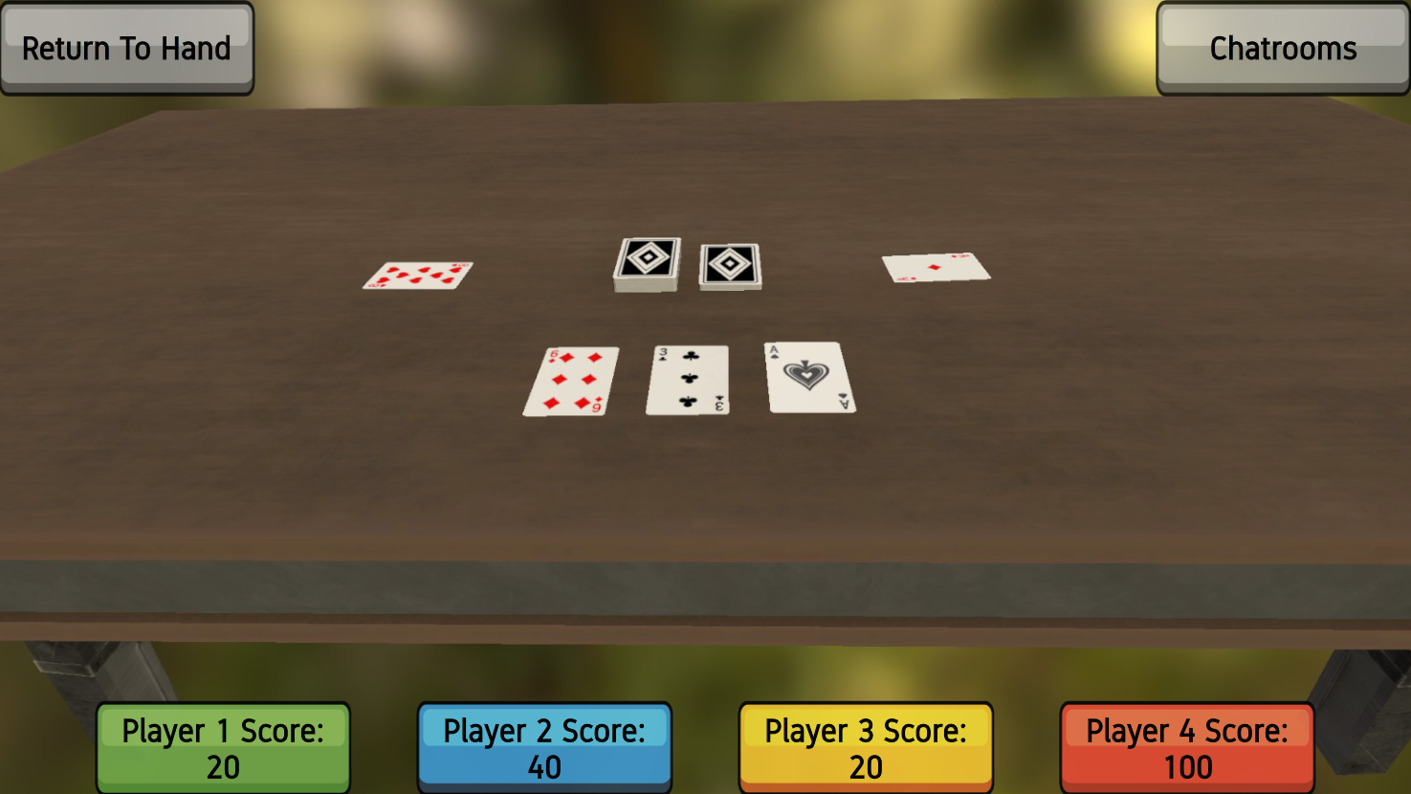

Slide 4
Players can choose from a variety of games to play with friends over a local network, without requiring an Internet connection

Slide 5
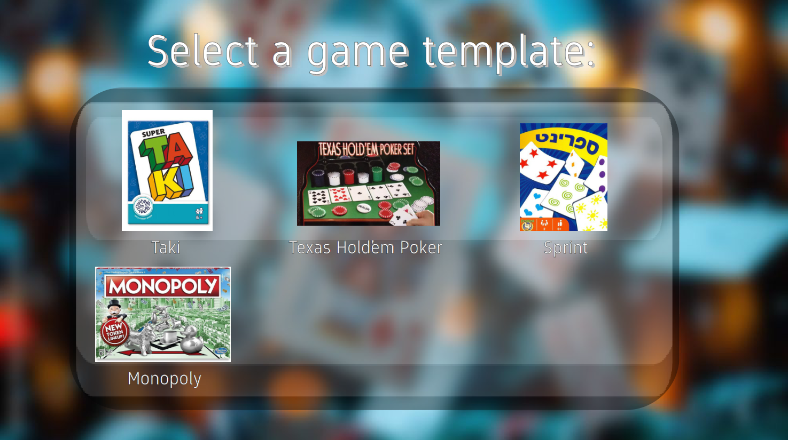

Slide 6
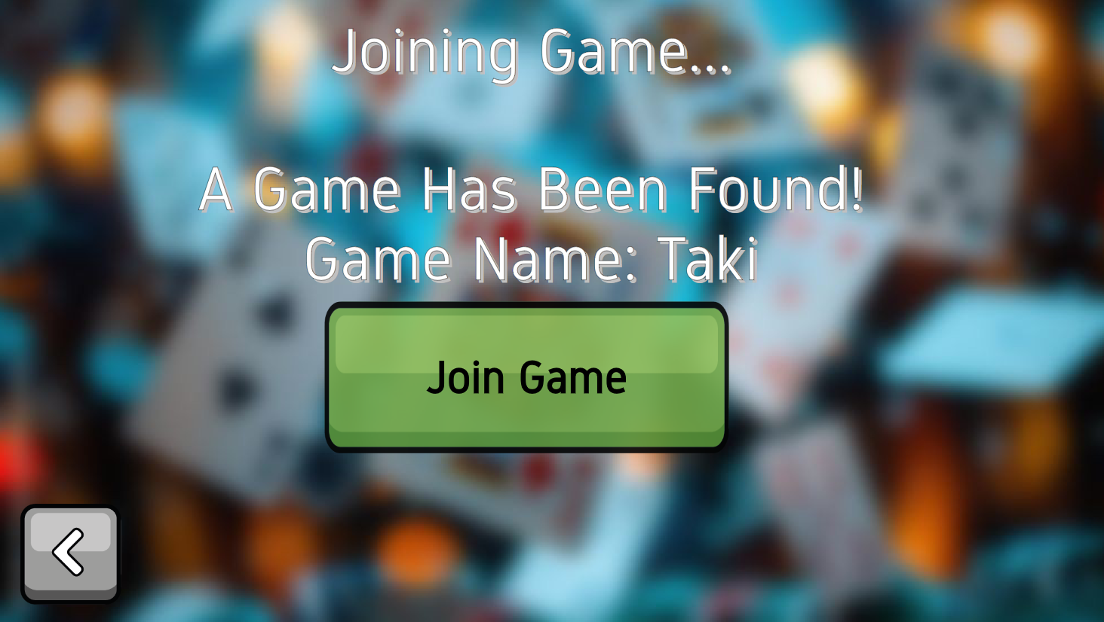

Slide 7
The game also provides tools to create new game templates for other players to experience and enjoy, with many options to customize their game, in order to bring out their creative vision

Slide 8
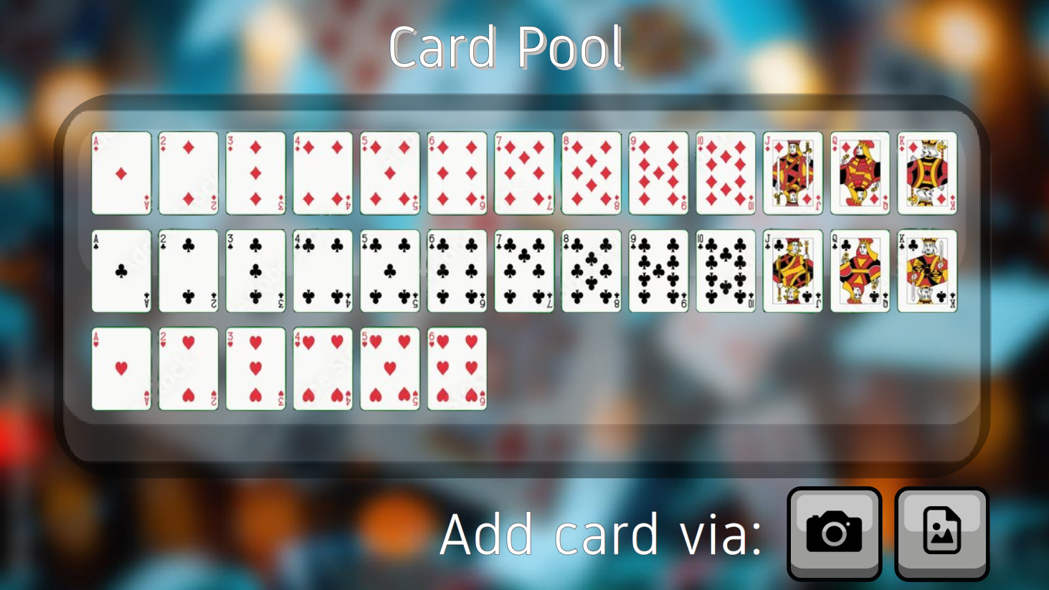

Slide 9




Technologies at Use:

Slide 10
Architecture

Slide 11
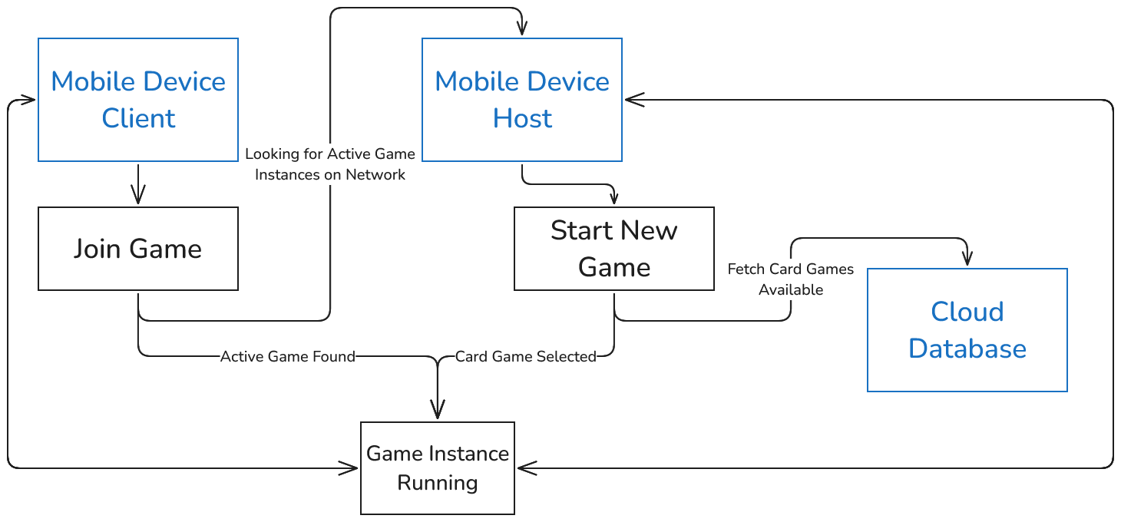

Slide 12
(Firebase integration for authentication, game template access)

Slide 13


Other Similar Games

